Slide 1
Comparison of Hierarchical Navigable Small World Querying Variants
Research Project Presentation for 605.746
By Affan Dhankwala

Slide 2
Introduction
High dimensional data consists of examples with numerous features.
Relevant in computer vision, natural language processing (NLP), fraud-detection services, recommender systems, etc.
Expensive nearest neighbor search.
Brute force methods are not suited for large scale datasets.
K dimensional trees fail in high dimensional datasets.

Slide 3
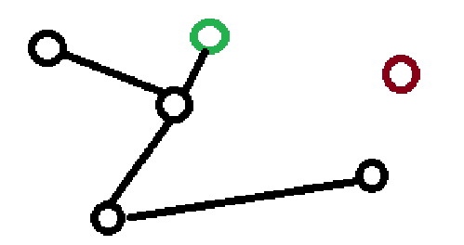
Approximate Nearest Neighbors (ANN)
ANN methods are a class of models that sacrifice accuracy for speed.
Focus on graph based such as navigable small worlds (NSW)s.
Data points are represented as nodes with edges connecting similar nodes.
Querying these structures begins at a random or starting node and performing a greedy search to find the nearest k nodes to the query.
NSWs are susceptible to local minimums.

Slide 4
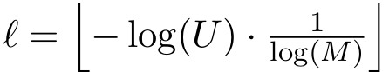
Hierarchical Navigable Small Worlds (HNSW)
Type of ANN method similar to layered NSWs.
Embed data points one by one similar to NSW but with max layer as
U is [0,1] and M is max neighbors. Log(M) tends to be greater than 1.
If we assume x~U, then x < 0.1 for –log(U) > 1.
Highest layer has 1-2 nodes and lowest is a dense NSW.
Querying involves starting at top and using distance heuristics to find closest node and then traversing down.
Maintain priority queue of closest neighbors (the beam) and return the top k.

Slide 5
HSNW shortcoming
Noted to not be high performing at high dimensions. Slow query time at those dimensions.
Extremely storage intense data structure.
Can still fall prey to local optima issues.
This presentation attempts to face these deficiencies with established querying variants.

Slide 6
HNSW Variants
Variants still utilize the HNSW structure but change some aspect to improve efficiency.
Fast inference for graph-based approximate nearest neighbor search (FINGER) by Chen et al. speeds up querying time by skipping intermediate distance calculations and adding more precomputations during HNSW building.
Distance adaptive beam search (DABS) proposed by Al-Jazzazi.
We hypothesize that FINGER will have less comparisons than HNSW and DABS but fall short of both of their recall rates. We also hypothesize DABS will have the higher recall rate at the expense of most comparisons.

Slide 7
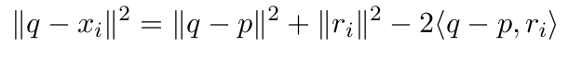
FINGER
Eliminates intermediate unnecessary calculations of all nodes with query
Creates projections vectors (points) randomly. Fine-tunes location during building.
Saves distance between projections and nodes to estimate where to look during querying.
Where q is the query point, xi is a candidate point (neighbor), p is a reference point, and ri=xi - p is the residual vector from reference point to the data point.

Slide 8
DABS
Dynamically adjusts beam width depending on dataset distribution.
Consider more neighbors with our large scale highly dense datasets.
Neighbors in the current nodes within the beam are explored and added to the beam if they are ‘good enough’.
This is what causes the beam to grow or shrink.

Slide 9
Datasets
Global vectors for word representation (GloVe) by Pennington et al.
2 billion tweets trained and 1.2 million words embedded.
4 dimensions: 25D, 50D, 100D, 200D

Slide 10
Experimental Approach
Wish to measure recall rates of all models on all datasets are varying levels of k
k was a measured within range [5, 50] with incrementor of 5.
Selected 1000 random words as queries and found all values of exact knn for all queries across all datasets; (100+ hours).
Track distance calculations during querying per model.

Slide 11
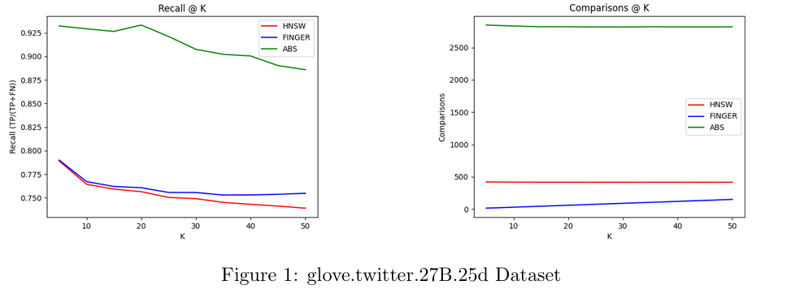
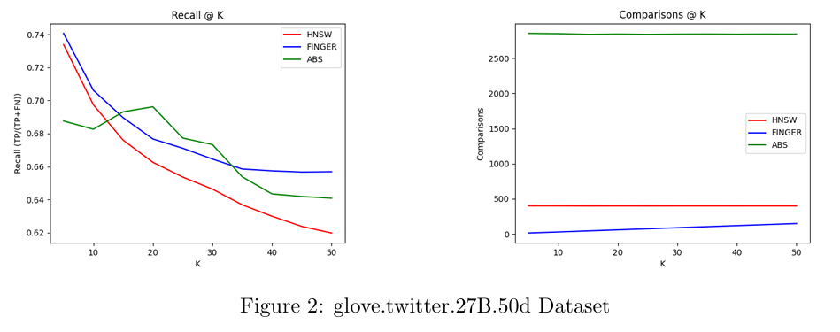
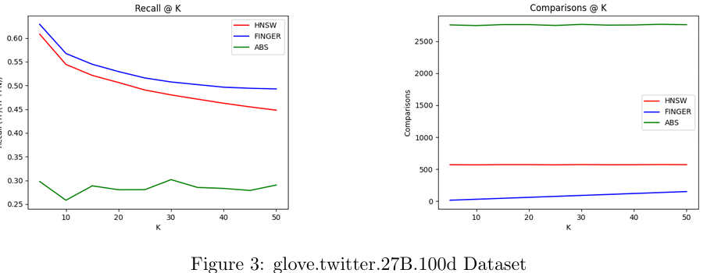
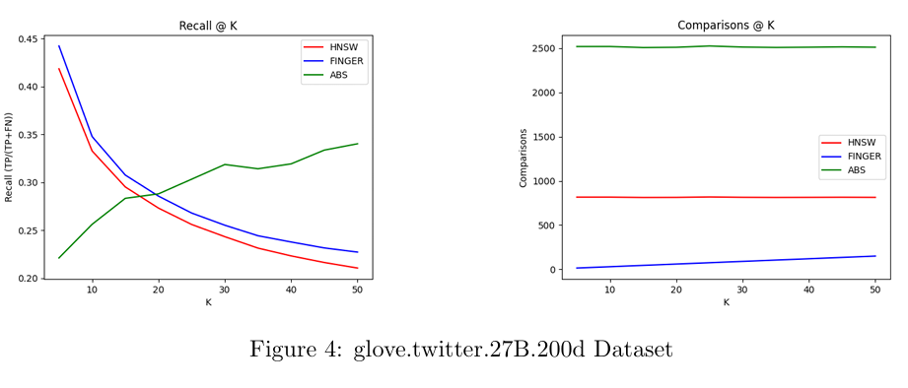
Experiment Results

Slide 12
Experiment Analysis
Recall decreases for all datasets as dimensions increase.
FINGER recall was higher than HNSW recall—contradictory to hypothesis.
DABS recall was high on 25D but dropped in 50D and 100D. Rose again at higher values of k in 200D.
FINGER had the least number of comparisons when looking for neighbors.
DABS had the largest number of comparisons.

Slide 13
Potential Shortcomings
Computational power limited higher dimensions and lack of dataset.
Could have created DABS variants that were tuned to each dataset.
Added a customized candidate pool multiplier for FINGER.

Slide 14
Further Research
Investigate hnswlib and find a way to modify bindings to gain more access to internal variables and methods.
Allow us to see topological structure of graphs.
Research into HNSW specific searches that take layering as factor of heuristics.

Slide 15
Copyright The Johns Hopkins University 2025. All rights reserved.

